Slide 1

IAIA Project 2024
IAIA Project #2
Gomoku Game Automation Using UR5E Robot Arm
School of Mechanical and Control Engineering Kwak, Jin(21900031)
Lim, Soonho(21900610)
An, Gyeonheal(21900416)
Han, Taegeon(21900793)
24.11.08
Industrial AI and Automation
Prof. Young-Keun Kim

Slide 2
1. Background
1) Gomoku Game with Computer in Real Life
Playing Gomoku in real life requires two people
2) Perform action with UR5E(Robot Arm)
Notes:
First the back ground of
primarily high power consumption and coil defects that lead to overheating and irregular temperature transmission.

Slide 3
2. Goal of the Project
Goal of the Project
User may play gomoku by him/herself with ur5e robot
Maintain user-friendly access to robot for convenient use
Specific goals
Apply Reinforcement learning for gomoku scenario(DP)
Perception of user’s gomoku stone position using image processing
Pick a baduk stone and place it for the optimal position using UR5E
Recognize the user face for gomoku records using DL(Pytorch based)
Notes:
The main goal of our project is to develop a machine learning-based model to detect coil defects in hot-air drying process equipment. Additionally, we aim to predict the Remaining Useful Life (RUL) of the equipment to proactively address potential failures.
Specifically, we want to achieve a detection accuracy of over 90% for identifying defects and ensure that 80% of our RUL predictions fall within an acceptable margin of error after our model is trained and tested. This will not only help us prevent coil-related failures but also ensure better equipment management and productivity.

Slide 4
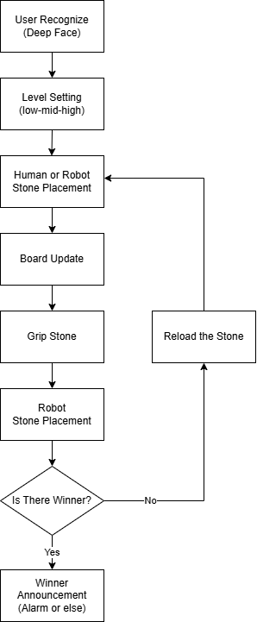
3. Flowchart

Slide 5
4. Expected outcome
Users can set up the game as they want and play Gomoku
They can choose difficulty levels and set the order for initial settings.
The user's face is recognized to check their match record against the Al
Each game's record is saved in the user data storage.

Slide 6
5. Schedule

